Slide 1

BTS
BTS
Notes:
Welcome to my 5 minute presentation. The topic for my presentation is BTS.

Slide 2
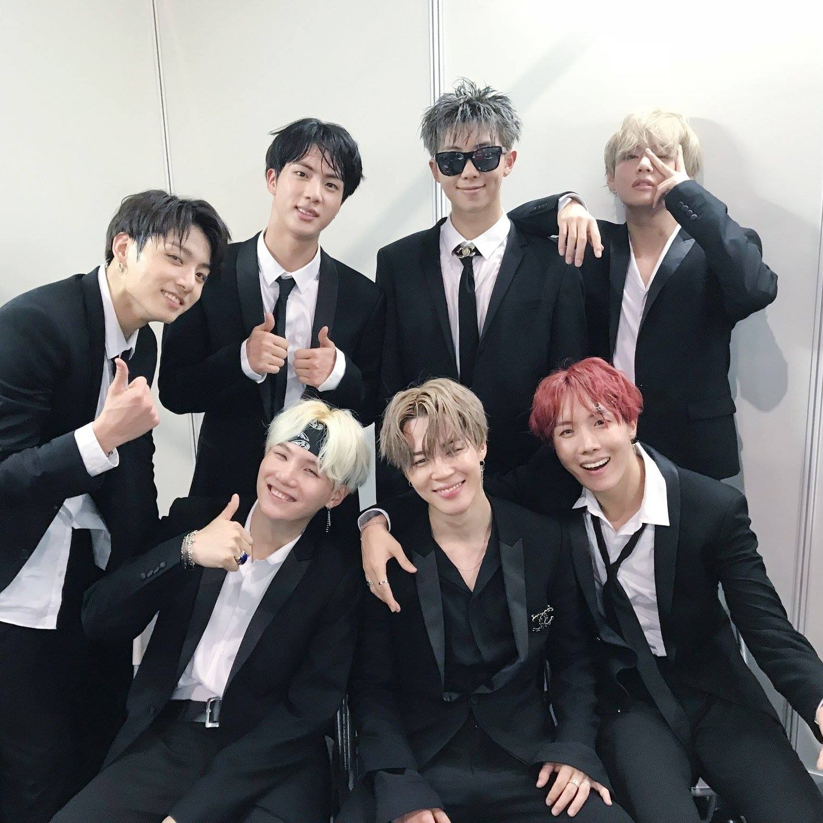

방탄소년단 / BTS
Debut : June 13th 2013
Notes:
BTS is a k-pop boy band group that debuted on 2013 June 13th. Their korean name is 방탄소년단 which translates to bulletproof boys.
BTS is part of BigHit Entertainment which is currently known as Hybe Corporation.
They consist of 7 members who are all currently serving in the Korean military.

Slide 3

RM
RM
김남준 / Kim NamJoon
AGE : 29
DOB : 1994 November 12th
Ends Service : 2025 June 10th
Leader, Rapper
Notes:
RM (김 남 준) in korean is the Leader of the group.
He is currently 29 years old.
His date of birth is 1994 November 12th.
And his service ends in June 10th 2025.
Some fun facts about RM is that,
He was the first member to join the group.
He is also smart with an IQ of 148 and is trilingual, fluently speaking Korea, English, and Japanese.

Slide 4

JIN
JIN
김석진 / Kim SeokJin
AGE : 31
DOB : 1992 December 4th
Ends Service : 2024 June 12th
Vocal
Notes:
Jin 김 석 진 in korean is the oldest in the group.
He is 31 years old and his date of birth is 1992 December 4th.
He is the first one to start service, making him the first one to end which is June 12th 2024.
Fun fact about him is that he has been scouted by a casting agent from Big Hit Entertainment while he was on his way to his university. This makes him the only one to be in the group without auditioning.

Slide 5

SUGA
SUGA
민윤기 / Min YoonGi
AGE : 31
DOB : 1993 March 9th
Ends Service : 2025 June 21st
Lead Rapper
Notes:
Suga 민윤기 is the lead rapper and is currently 31 years old.
His date of birth is 1993 March 9th.
He is the last one to finish military service which is June 21st 2025.
Suga is serving the longest because he has been selected as a social service agent due to a shoulder injury that prevents him from performing rough activity
One fun fact about Suga is that he does not remember why he chose his name as Suga.

Slide 6

J-HOPE
J-HOPE
정호석 / Jung HoSeok
AGE : 30th
DOB : 1994 February 18th
Ends Service : 2024 October 17th
Main Dancer, Rapper
Notes:
J-Hope or 정호석 in korean is the Main dancer.
His date of birth is February 18th 1994 making him 30 years old.
His service ends in October 17th 2024.
One fun fact about J-Hope is that he was a street dancer before auditioning for Big Hit.

Slide 7

JIMIN
JIMIN
박지민 / Park JiMin
AGE : 28
DOB : 1995 October 13th
Ends Service : 2025 June 11th
Lead Vocal
Notes:
Jimin aka 박지민 in korean is one of the Lead Vocal who is currently 28 years old.
His date of birth is October 13th 1995 and ends service on June 11th 2025.
One fun fact about Jimin is that he studied contemporary dance. This led to many challenges during his trainee period since K-pop dance and contemporary dance are quite different.

Slide 8

V
V
김태형 / Kim TaeHyung
AGE : 28
DOB : 1995 December 30th
Ends Service : 2025 June 10th
Vocal
Notes:
V 김태형 is 28 years old .
His date of birth is 1995 December 30th.
And ends service in June 10th 2025.
V is the only one in the member serving for a special team. He is currently assigned to the SDT, which focuses on counter-terrorism and other special operations.
One fun fact about V is that he ended up auditioning for Big Hit after tagging along with a friend to the audition. A staff member, noticing his potential, persuaded him to give it a shot.

Slide 9

JUNGKOOK
JUNGKOOK
전정국 / Jeon JungKook
AGE : 26
DOB : 1997 September 1st
Ends Service : 2025 June 11th
Lead Vocal
Notes:
Jungkook or 전정국 in korean is the youngest in the group.
His date of birth is 1997 September 1st, making him 26.
His service ends in June 11th 2025.
One fun fact about Jungkook is that he has been scouted by multiple major entertainment companies. However, he rejected the offers and went to BigHit (which was a small company back then) and that is just because he was impressed by RM, who was already signed with the company.

Slide 10

Notes:
And that is all the basic information about BTS.

